Slide 1
WHO AM I!!?

Slide 2
Basic information
My name is Adan Imran.
I was born and raised in Karachi
I have studied from Beaconhouse School System from Pre-Nursery till A-levels.
I was a gold medalist in my Olevels and silver medalist in my Alevels.
I am currently a BBA freshmen at IBA Karachi.

Slide 3
Skills and qualities
Written and verbal communication
Good Interpersonal skills
Critical thinking/analysis
Bilingual Fluency in English and Urdu
Team player
Honest
Loyal
Compassionate
Hardworking

Slide 4
Hobbies
Reading books
Listening to music
Watching movies and TV shows
Baking
Volunteering

Slide 5










Someone of my favourite books!

Slide 6
Movies
Genres I watch includes rom coms, action, crime thriller, suspense thrillers, psychological thrillers, fantasy and superhero fiction.
I think horror movies are extremely lame

Slide 7


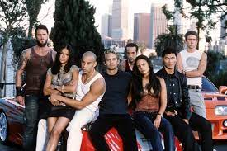







Slide 8

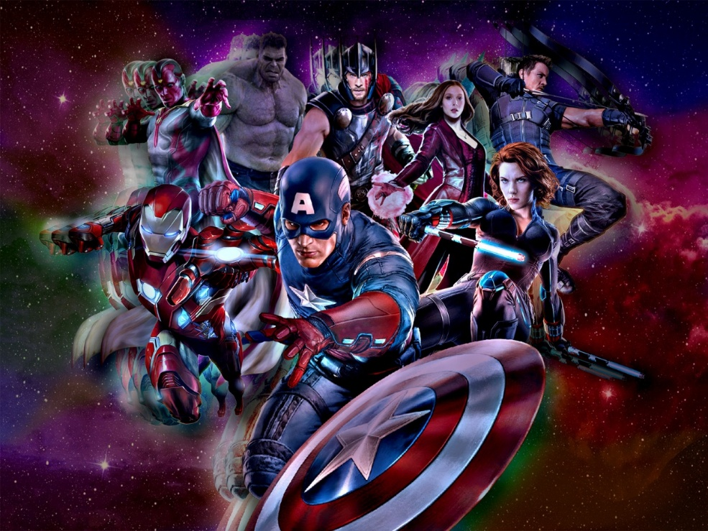

I AM A HUGE MARVEL AND HARRY POTTER FAN!

Slide 9
TV Shows
I love watching sitcoms, crime dramas, family dramas, fantasy and suspense thrillers.
Brooklyn Nine Nine, Schitt’s Creek, Sherlock, You, Vampire Diaries, Gilmore Girls and Squid Game are some of my favourite shows.

Slide 10




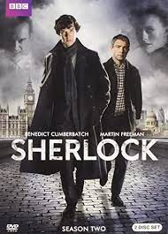



Slide 11


I AM A FAN OF ONE DIRECTION AND HARRY STYLES!

Slide 12
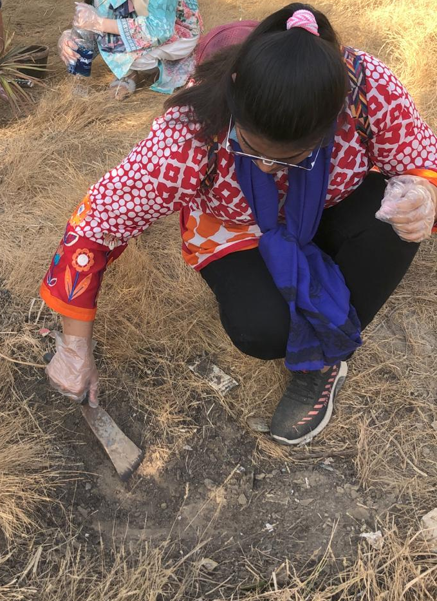
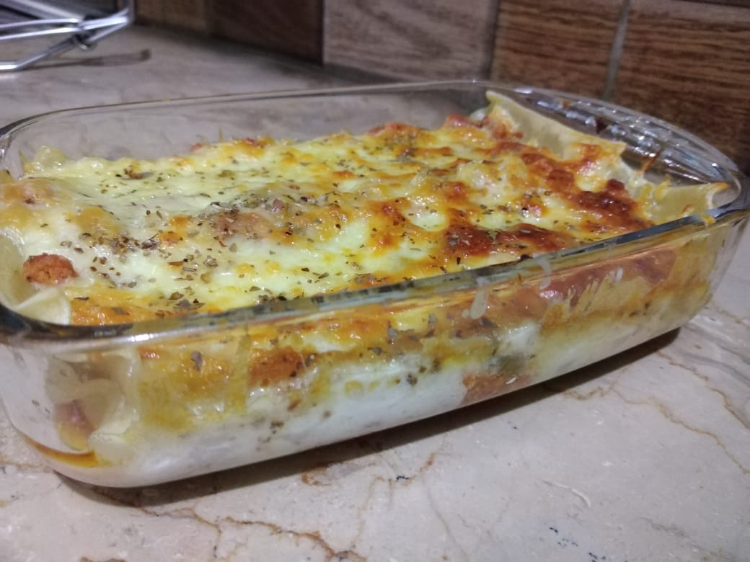
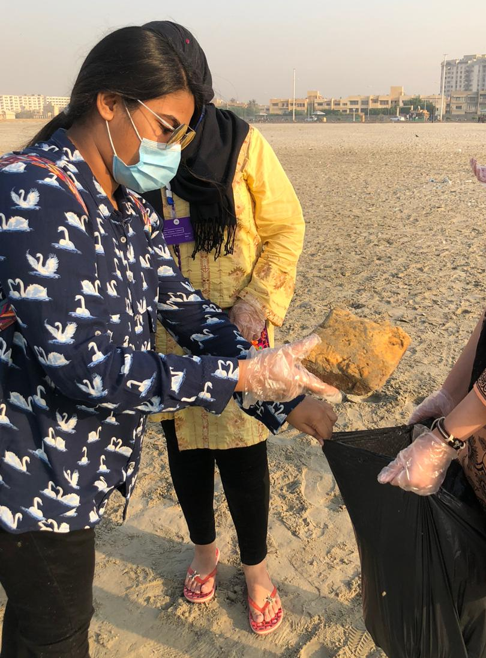
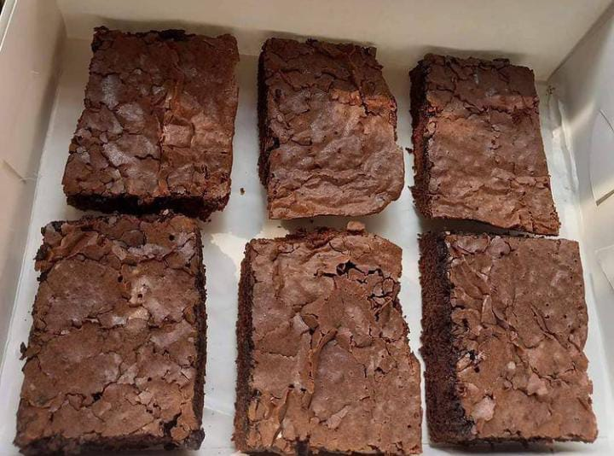
Some pictures of things I’ve baked and activities I’ve volunteered for!

Slide 13
My Aspirations
I have always been interested in how the business world works especially the branding and marketing aspect of it.
I plan to major in marketing in my undergrad as well as get an MBA from NYU STERN or Wharton.
My goal is to find a financially stable and fulfilling job at a top notch multinational firm.
I want to give back to my parents tenfold of what they spent on me and sacrificed for me and make a difference in the world in whatever way I can.
I want to go backpacking all over the world with my bestfriends.
I want to go on a separate trip around the world with my family as well.

Slide 14
Reflection on the course ICA
Intro to Computer Applications proved to be a very helpful course for me.
I learned to use MS Excel very well and unearthed many features of MS Word and MS Powerpoint which were previously unknown to me.
I came to know about GitHub which I had never heard of before and it turned out to be a very interesting tool.
The typing course offered by my instructor Sir Waseem Arain was an excellent way to polish my typing skills and am sure will help in future endeavors.

Slide 15
